Slide 1


Slide 2

Agenda
Refresher on FINEder - Who we are / What we do
Hypothesis
Data preprocessing
Splitting the variables into Predictors and Response Variable
Model Selection
Creating and fitting the model
Results

Slide 3
Refresher
FINEder is an app aimed at helping people and businesses across NYC predict and avoid the likelihood of receiving a high parking fine in a specific area
Our mission is to create a hassle-free journey for travelers, residents and coworkers. Our application safeguards individuals from parking violations in the city and at the same time avoids unnecessary clutters and traffic jams.
We plan to use NYC Parking Violation Data to predict how much a consumer or a business entity will be charged for incurring a parking violation.
https://www.kaggle.com/datasets/new-york-city/nyc-parking-tickets

Slide 4

Hypothesis
We hypothesize that the use of specific quantitative and qualitative variables in the NYC parking data set can be successful in predicting the fine amount of violations
These results can help our company develop insights on violations based on various criterias, to help our users avoid potential fines
The models we tested on the 1,000 records were:
Random Forest
Decision Tree
Naive Bayes

Slide 5
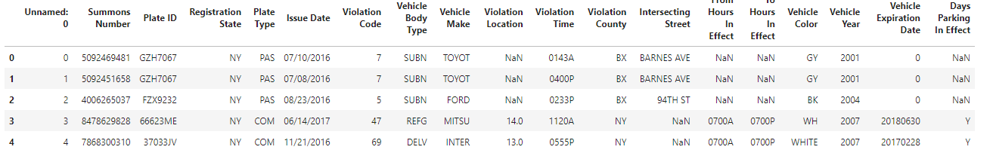
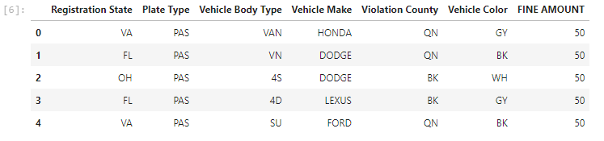
Preprocessing - Dropping irrelevant columns

Slide 6
Preprocessing - Aggregating remaining columns
Found count of unique values for each column and used mapping to adjust any inconsistencies in spelling / category types
For columns with many unique values, unique values with very low counts were grouped together and mapped under “OTHER”
Columns cleaned using mapping: Registration State, Plate Type, Vehicle Body Type, Vehicle Make, Violation Time, Violation County, Violation Color

Slide 7
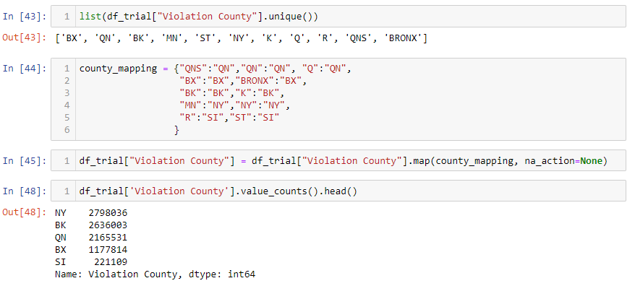
Preprocessing - One of the many examples of aggregating
Example: Violation County had
many different Abbreviations/Spellings

Slide 8
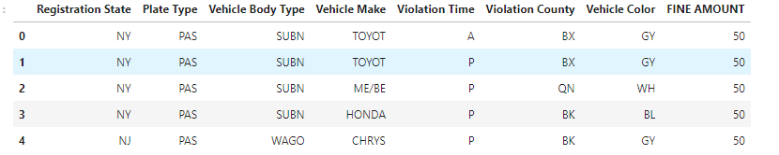
Preprocessing - Further cleaning
Dropping null values and more columns
Final product before label encoding
Dropped “Violation code” since violation code is a direct reflection of “FINE AMOUNT”

Slide 9
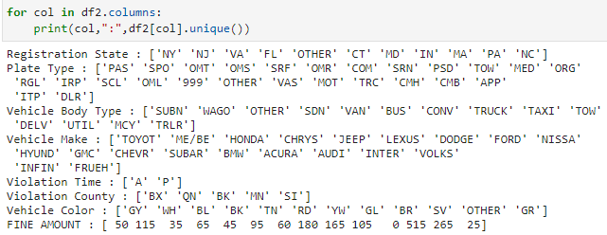
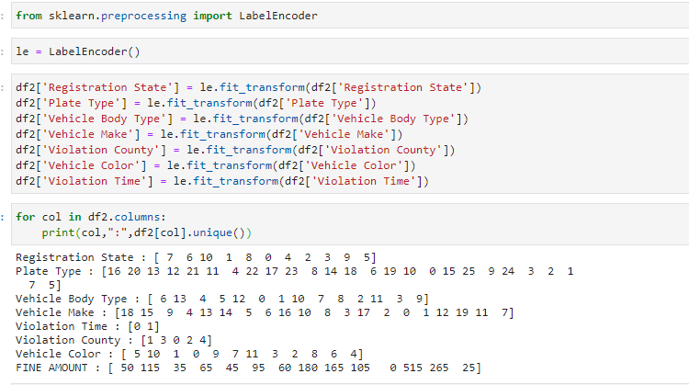
Preprocessing - Label Encoding
Converted the remaining categorical values into numerical values
Before Encoding After Encoding

Slide 10
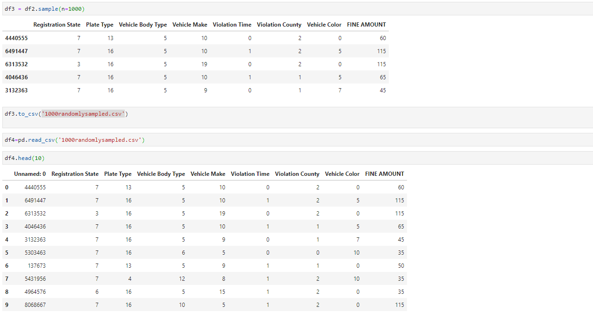
Model Selection
Randomly selected 1000 rows without replacement for our validation set

Slide 11
Splitting the variables into Predictors and Response Variable
“Fine Amount” is the response variable, the variable we want to predict with our X-variables/predictors

Slide 12
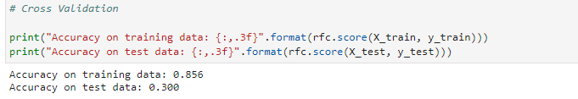
Creating and fitting the model - Results

Slide 13

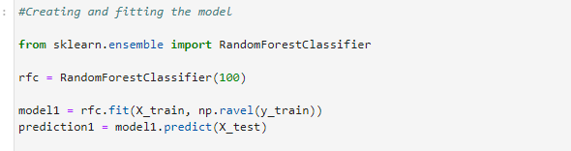
Splitting into train and test set - Random Forest

Slide 14
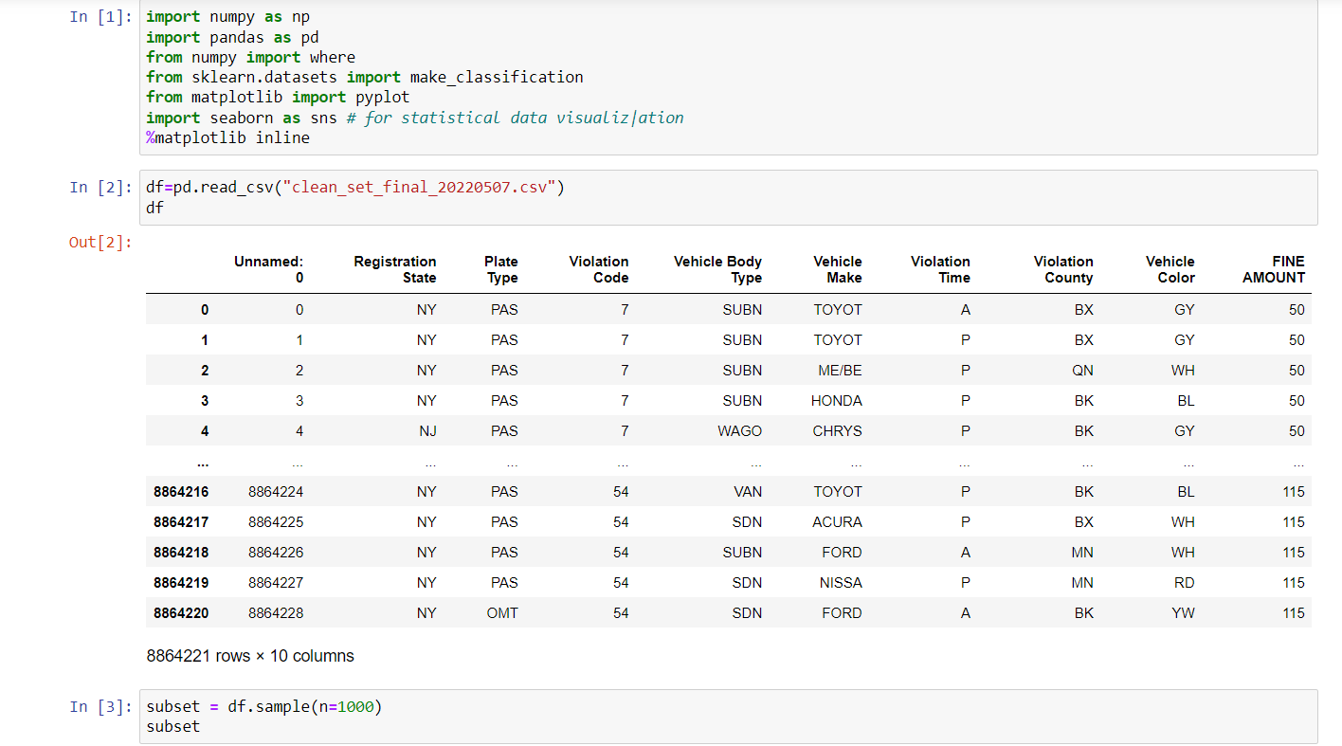
Creating and fitting the model 2 - Decision Trees

Slide 15
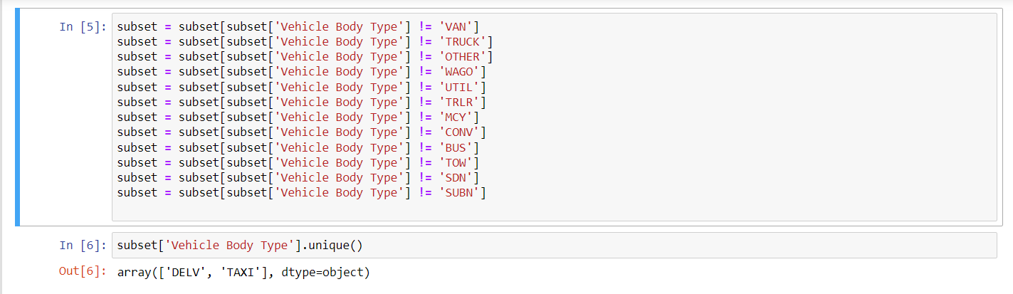
Creating and fitting the model 2 - Decision Trees

Slide 16
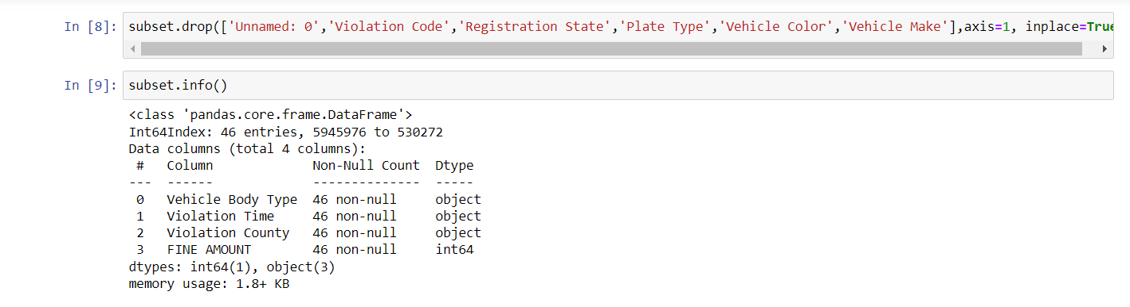
Creating and fitting the model 2 - Decision Trees

Slide 17
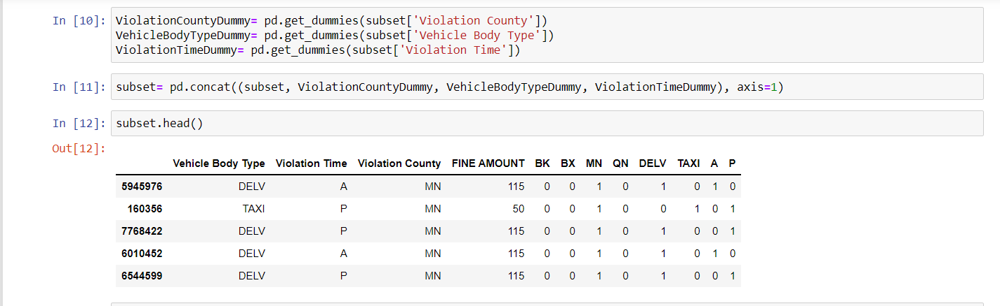
Creating and fitting the model 2 - Decision Trees

Slide 18
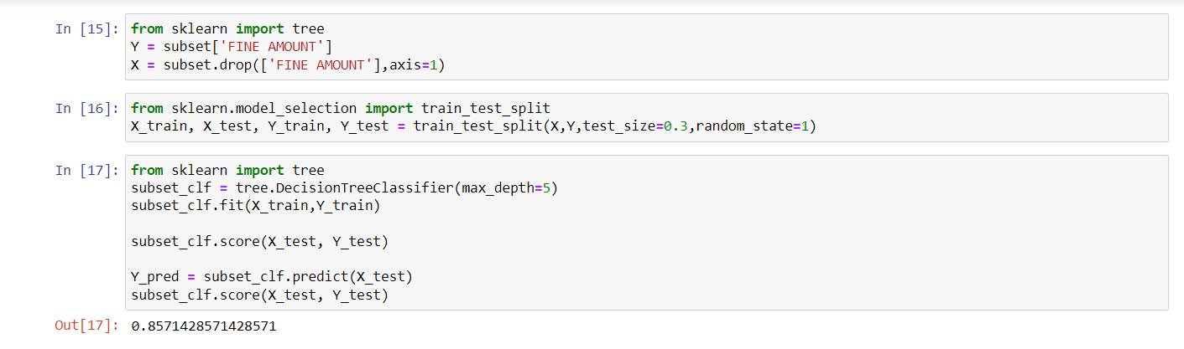
Creating and fitting the model 2 - Decision Trees

Slide 19
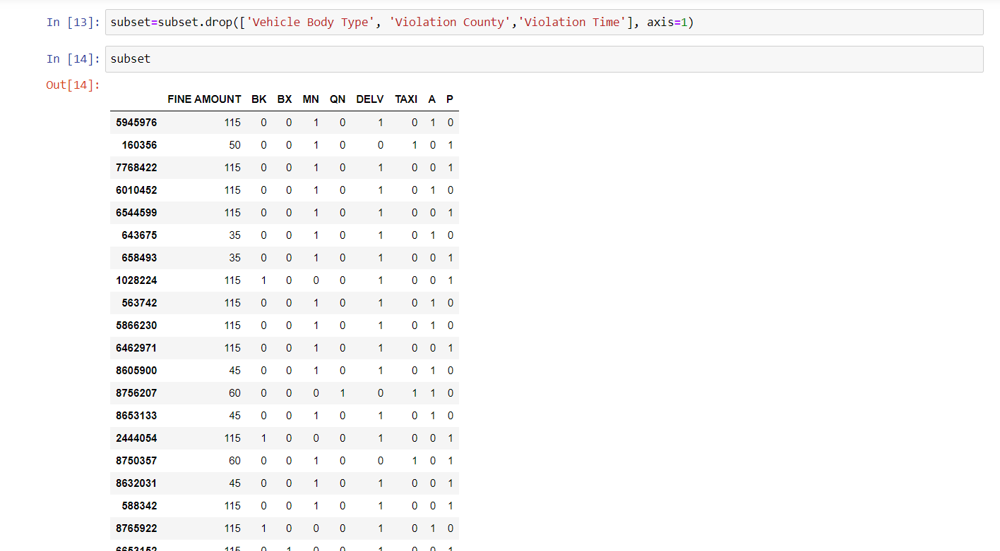
Creating and fitting the model 2 - Decision Trees

Slide 20
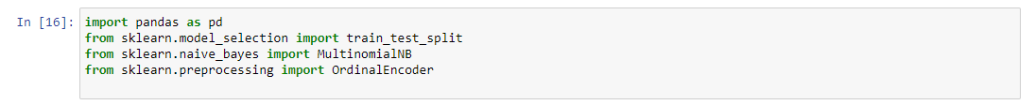
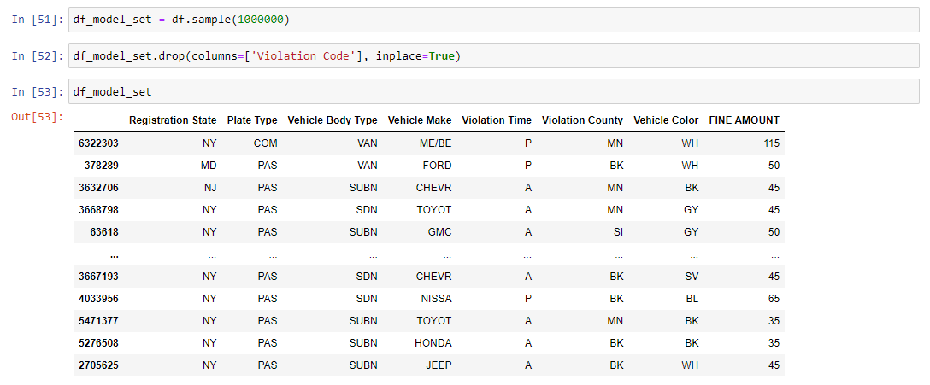
Cleaning the Data for Model 3 - Naive Bayes

Slide 21
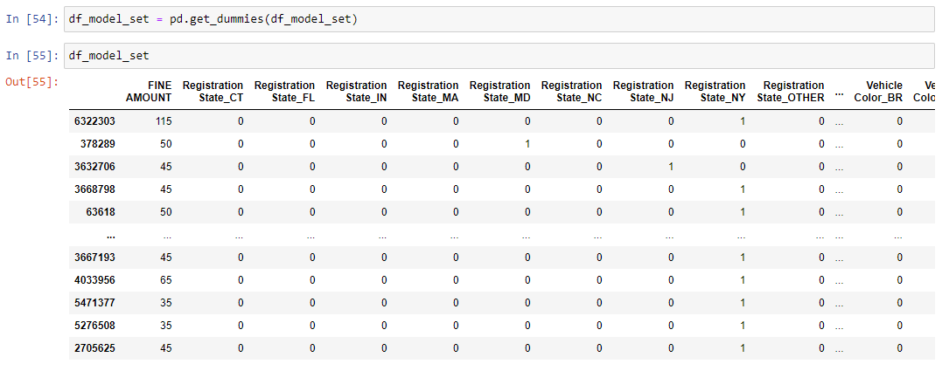
Encoding the Data for Model 3 - Naive Bayes

Slide 22
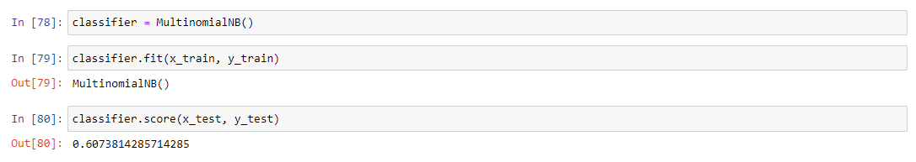
Fitting and Predicting with Model 3 - Naive Bayes

Slide 23
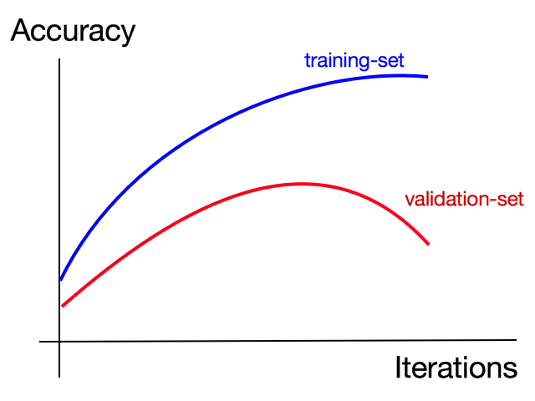
Results - Cross validation

Slide 24
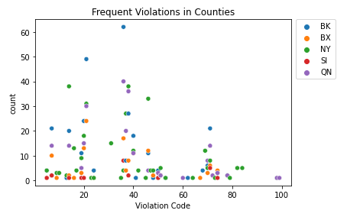
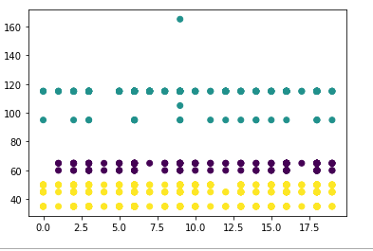
Other Data Visualization
Scatter plot showing the common violations per county
Clustering of Vehicle Makes and Fine Amounts
*Based on 1,000 random records
Notes:
K means clustering

Slide 25

Final Thoughts / Comments / Conclusions
To improve our models and increase accuracy, we will have to continue validating our data
Data will have to be cleaned further to remove any inconsistencies
Various models will be tested on data, to find the best and most accurate fit for our dataset

Slide 26

Thank You!
Please reach out if you have any questions:​
Eric Chow - Eric.Chow@Fineder.com​
Afaqul Haque - Afaqul.Haque@Fineder.com​
Urvaksh Irani - Urvaksh.Irani@Fineder.com​
Paul Leefoon – Paul.Leefoon@Fineder.com​
Shannon Paes - Shannon.Paes@Fineder.com​
Tony Tan - Tony.Tan@Fineder.com

